Slide 1
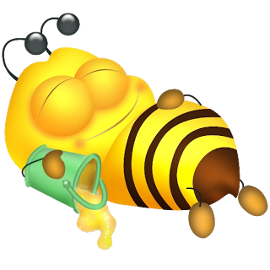
THE BEE’s KNEE’s
Shane Carty | 12713771
Adam Moore | 12757645
Stephen Gallagher | 12751175
Fergus Mc Donald | 12728719

Slide 2
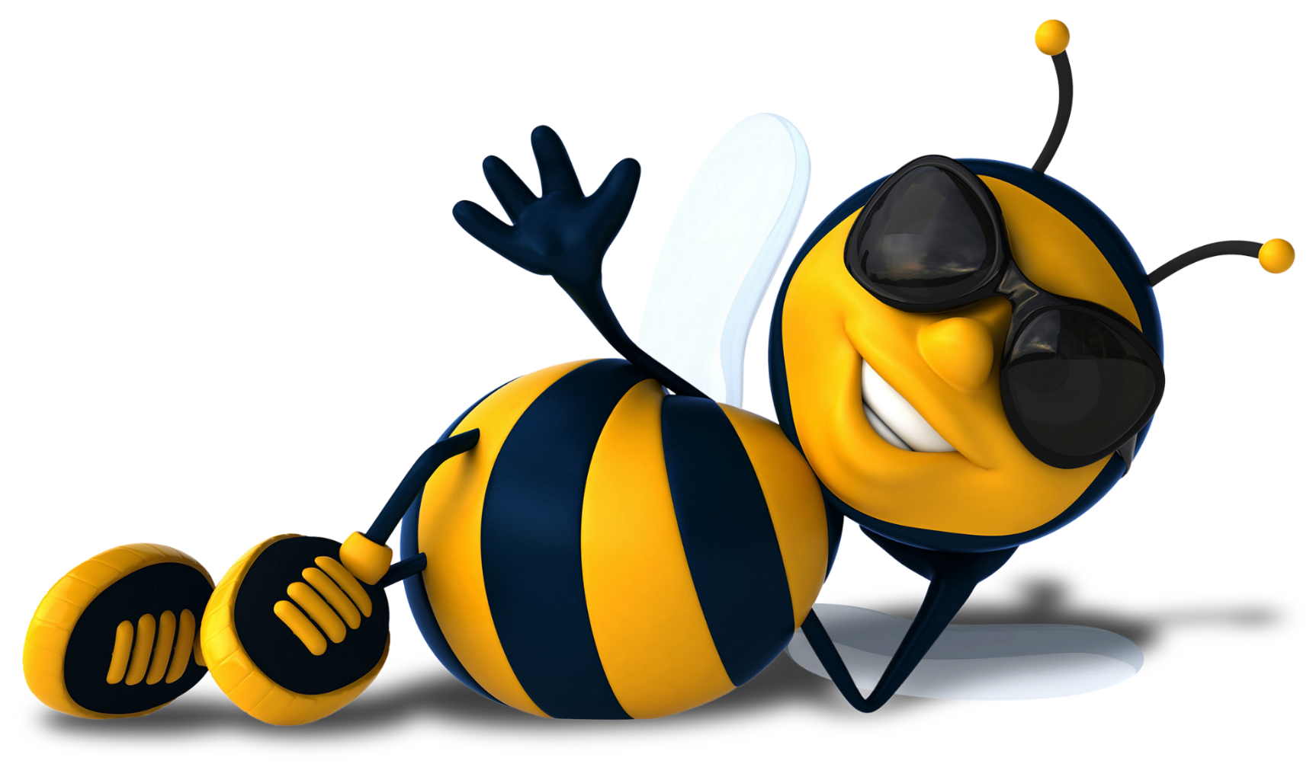
Requirements
Fully functioning Beehive which models:
The collection of pollen and nectar
Defence of the hive by bees and keeper
Creation of new bees
Feeding of larvae
Collection of honey by the bee keeper
Honey is implicitly created when nectar is brought back to hive

Slide 3
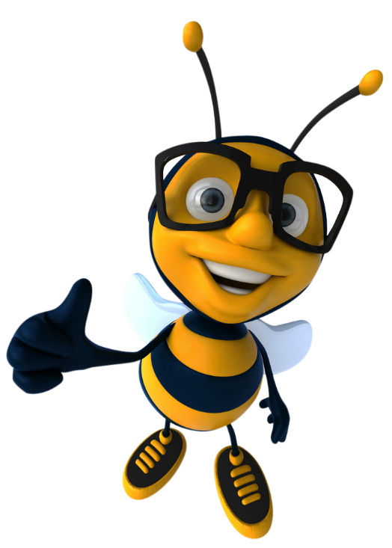
Analysis

Slide 4
Role Model
Role Name: Pollen/nector Collector
Description: Leave hive to search for flowers with pollen and then return to hive and insert pollen into hive
Protocols and Activities: Protocols; - Check for pollen in flower - Extract pollen from flower - Insert pollen into beehive Activity; -Search for flowers -Carry Pollen back to beehive
Permissions: -Read/Change Flower pollen level -Read/Change Hive pollen level
Responsibilities; Liveness: Pollen Collector = (Search Flowers, Check for pollen, Extract Pollen, Carry Pollen back to beehive, insert pollen) Safety: 0 < Hive Pollen Levels < N
Role Name: Egg Layer
Description: Lays larvae eggs to produce more bees
Protocols and Activities: Protocols: Lay larvae egg Activity: Check Larvae Levels
Permissions: Read/Change larvae number
Responsibilities; Liveness: Egg Layer(Check larvae levels, Lay larvae egg) Safety: N/A

Slide 5
Role Model
Role Name: Colony Defender
Description: Colony defender has to patrol the bee hive perimeter and defend it from attack
Protocols and Activities: Protocols Check is hive safe Activity Neutralize threat
Permissions: Read/change hive safety status
Responsibilities; Liveness: Colony Defender=(check is hive safe, neutralize threat) Safety: colony breached = false
Role Name: Larvae Feeder
Description: The agent doing this role has to feed the larvae
Protocols and Activities: Protocols Feed Larvae Activities Check larvae hungry status
Permissions: Read/change larvae hungry status, Read/change honey levels
Responsibilities; Liveness: Larvae Feeder = (check larvae hungry status, feed larvae) Safety: larvae hungry < 25%

Slide 6
Role Model
Role Name: Queen Mater
Description: This role involves mating with queen to produce bees
Protocols and Activities: Protocols Compete for queens attention with other drones Mate with queen Activities N/A
Permissions: Read queen busy status
Responsibilities; Liveness: Queen mater(Compete for queens attention with other drones, mate with queen) Safety: N/A
Role Schema: Hive Guard
Description: The Beekeeper keeps an eye on hive throughout the day to guard it from any possible danger
Protocols and Activities: Protocols; Checks Bee Hive safety Remove Bee Hive Threat Activity; N/A
Permissions: Read/Change Bee Hive (Safety)
Responsibilities; Liveness: Hive Guard = (checks bee hive safety, remove bee hive threat) Safety: Bee hive safe = true

Slide 7
Role Model
Role Schema: Honey Holder
Description: This agent stores the honey
Protocols and Activities: Protocols; N/A Activity; N/A NOTE: The Honey Holder only has the role of holding honey and nothing else, so has no activities or protocols.
Permissions: N/A
Responsibilities; Liveness: N/A Safety: Honey_Level < N
Role Schema: Pollen Producer
Description: These are Flowers that produce pollen for the worker bees to forage from
Protocols and Activities: Protocols; Release Pollen to attract Bees Activity; Produces Pollen
Permissions: Change Pollen Amount
Responsibilities; Liveness: Pollen Producer = (Produces Pollen, Release Pollen to attract Bees) Safety: N/A

Slide 8
Role Model
Role Schema: Beehive Builder
Description: Construct an artificial beehive where the bees can live.
Protocols and Activities: Protocols; -Assemble Beehive -Insert Queen Bee Activity; -Find suitable setup location
Permissions: -Generate/Change Beehive
Responsibilities; Liveness: Beehive Builder = (Find suitable setup location, Assemble Beehive , Insert Queen Bee) Safety: N/A
Role Schema: Honey Extractor
Description: Extract excess honey from the beehive.
Protocols and Activities: Protocols; -Extract honey from beehive Activity; - N/A
Permissions: -Read/change honey level
Responsibilities; Liveness: Honey Extractor = (Extract honey from beehive) Safety: honey level > 0

Slide 9
Role Model
Role Schema: Honey Packager
Description: Package the honey extracted from the beehive.
Protocols and Activities: Protocols; N/A Activity; Package honey
Permissions: N/A
Responsibilities; Liveness: Honey Packager = (Package honey) Safety: N/A

Slide 10
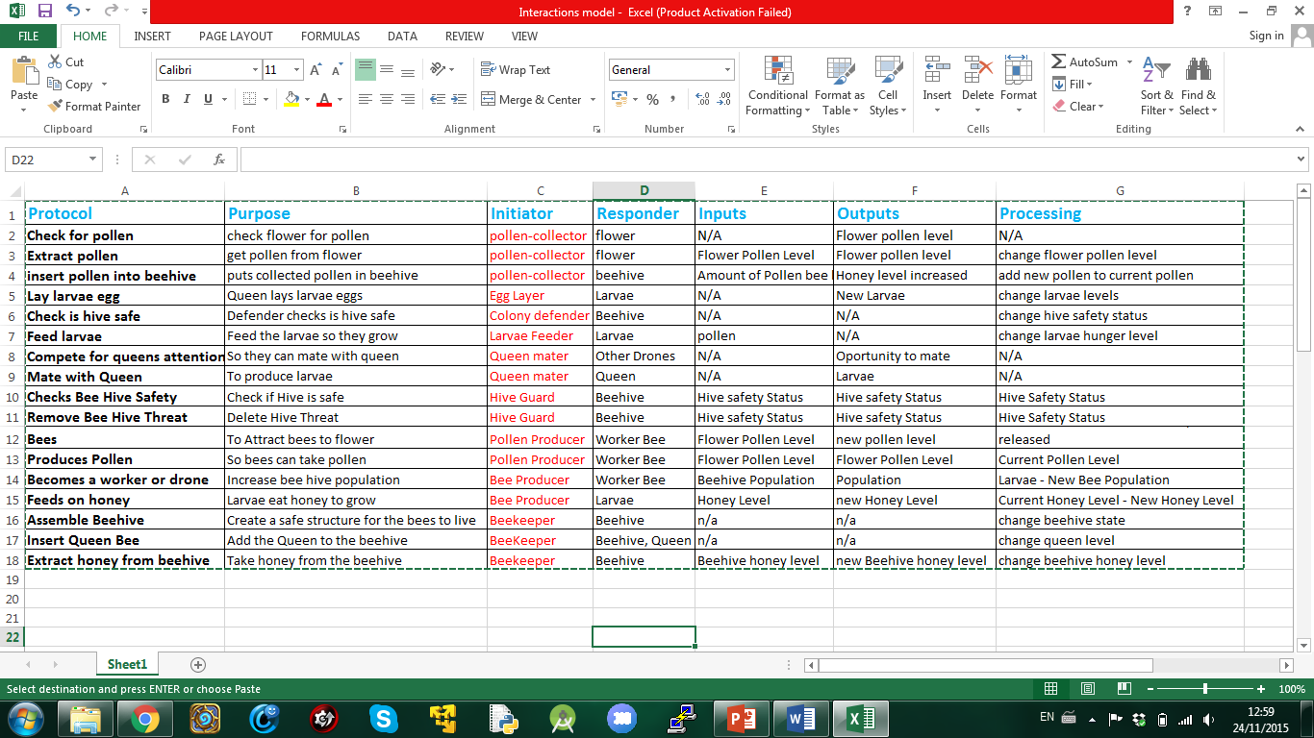
Interaction Model

Slide 11
Design

Slide 12
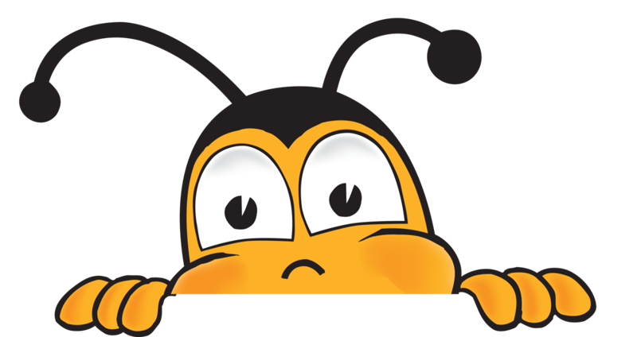
Agent Model
Roles: Agents:
Lay Eggs Queen Agent
Colony Defender Worker Agent
Pollen Collector Drone Agent
Larvae Feeder Bee Hive Agent
Mate with Queen Larvae Agent
Colony Builder Beekeeper Agent
Honey Extractor Flower Agent
Maintainer
Honey Packager
Hive Guard
Honey holder
Pollen Producer
Bee Producing

Slide 13
Agent
Model
Worker Agent
Colony Defender
Pollen Collector
Larvae Feeder
Beekeeper Agent
Drone Agent
Honey Extractor
Beehive Builder
Hive Guard
Honey Packager
Mate with Queen
Queen Agent
Flower Agent
Larvae Agent
Lay Eggs
Beehive Agent
Pollen Producer
Bee Producer
Honey Holder

Slide 14
Acquaintance Model
Beekeeper Agent
Maintain Beehive
Beehive Agent
Worker Agent
Queen Agent
Drone Agent
Mate with Queen
Collect
nectar
Feed
Larvae
Larvae Agent
Produce
Larvae
Flower Agent
Lay Drone Eggs

Slide 15
Service Model
Worker Agent
Service | Inputs | Outputs | Pre-condition | Post-condition
Feed Larvae | Larvae Hunger level | Larvae hunger level | Larvae hunger level > 0, Honey level > 0 | Larvae hunger level reduces
Defend Hive | Hive safety status | Hive Safety Status | Hive under threat | Hive safe
Collect Pollen | Pollen Amount | Pollen Amount | Pollen Amount < 0 | Bee pollen held > 0
Queen Agent
Service | Inputs | Outputs | Pre-condition | Post-condition
Lay eggs | Hasn’t laid 2000 eggs | X Larvae’s, Has laid 2000 eggs | Eggs in queen < 0 | Larvae level + X

Slide 16
Service Model
Drone Agent
Service | Inputs | Outputs | Pre-condition | Post-condition
Compete for Queens attention with other drones | Amount of competing drones | Drone that wins the queens attention | Drones > 0, Queen > 0 | Drone granted attention > 0
Mate with Queen | Drone that won attention | Fertilised Queen | Drones > 0, Queen > 0 | Drone death > 0 Queen fertilised eggs > 0
Flower Agent
Service | Inputs | Outputs | Pre-condition | Post-condition
Release Pollen to attract Bees | Pollen level | Number of bees attracted, new pollen level | Pollen level > 0 | N/A
Produces Pollen | Pollen increase rate | Amount of pollen increased | Flower > 0 | Pollen level > 0
Beehive Agent
Service | Inputs | Outputs | Pre-condition | Post-condition
Holds honey | Honey level | Honey level | Honey level > 0 | n/a

Slide 17
Service Model
Larvae Agent
Service | Inputs | Outputs | Pre-condition | Post-condition
Becomes Worker or Drone Bee | Larvae Amount, Worker Bee Amount, Drone Bee Amount | Larvae Amount, Worker Bee Amount, Drone Bee Amount | Larvae > 0 | Worker bee > 0 || Drone bee > 0
Feeds On Honey | Honey Level | Honey Level | Honey Level > 0 | Larvae Hunger Dropped > 0
Beekeeper Agent
Service | Inputs | Outputs | Pre-condition | Post-condition
Extract Honey from Beehive | Honey Level | Honey Level | Honey Level > 0 | Honey Taken > 0
Package Honey | Amount of honey to be packaged | Amount of the honey was packaged | Packaging in stock > 0 | Honey Packaged > 0
Checks Beehive Safety | Beehive Safety | Beehive Safety | Beehive Safety = False | Beehive Safety = True
Remove Beehive Threat | Threat type/status | Threat Removed | Hive Threat level > 0 | Threat Removed = True
Assemble Beehive | Material List | Amount of hives constructed | Materials > 0 | Hives constructed > 0
Insert Queen Bee | Queen Bee ID | Hive queen was inserted | Queen Bee > 0 | Queen in inserted hive > 0

Slide 18
Summary
We have shown how to model a functioning beehive as a multi-agent system
Kept things simple to avoid complexity
Had to limit the behaviour and protocols in order to keep them manageable
This project demonstrates the usefulness of the GAIA methodology when designing multi-agent systems
Thanks for stopping by!

